Slide 1
KARABUK UNİVERSİTY
Career Application and Research Center

Slide 2
Contents
Structure of the Career Center
Online Platforms
Activities
Sources

Slide 3
Structure of the Career Center
OUR CENTER CONTINUES ITS ACTIVITIES UNDER THE ROOF OF KARABÜK UNIVERSITY RECTORATE.
AS A CAREER CENTER (UNİKARMER), WE ARE AWARE THAT OUR COUNTRY'S PLACE FOR ITSELF IN THE INTERNATIONAL ARENA IS ONLY POSSIBLE WITH SELF-TRAINED INDIVIDUALS IN EVERY FIELD.
THE MOST IMPORTANT STAGE IN THE EDUCATION AND TRAINING OF THESE INDIVIDUALS WHO WILL SHAPE THE FUTURE OF THE COUNTRY IS UNIVERSITY EDUCATION.

Slide 4
IT IS OF GREAT IMPORTANCE TO INTRODUCE ALL CAREER-FOCUSED INNOVATIONS IN UNIVERSITY EDUCATION WITH A DIFFERENT APPROACH FROM OTHER HIGHER EDUCATION INSTITUTIONS AND TO CREATE AN ACADEMIC PERSPECTIVE. FOR THIS REASON, WE ADOPTE THE MAIN GOAL OF CREATING STUDENTS' CAREER AWARENESS FROM THE FIRST MOMENT THEY ENTER THE UNIVERSITY, GUIDING THEM IN DEVELOPING THEIR INTERESTS AND SKILLS AND MAKING THEIR CAREER PLANS.

Slide 5
IN THIS CONTEXT, WE HAVE ADOPTED THE IMAGE OF "THE UNIVERSITY THAT PROVIDES ITS OWN EMPLOYMENT" AS A GUIDE TO TRAINING GRADUATE CANDIDATES WHO ARE EQUIPPED IN EVERY FIELD, PREFERRED, HIGHLY EMPLOYABLE IN OUR COUNTRY AND IN THE WORLD. EVEN THOUGH OUR CENTER SEEMS TO BE A STUDENT-FOCUSED CENTER, IT ALSO PROVIDES CONSULTANCY SERVICES TO THE ADMINISTRATIVE AND ACADEMIC STAFF OF OUR UNIVERSITY, WHICH HAS VARIOUS PROJECTS AND SOME GOALS FOR THE FUTURE.
Notes:
Dünyada mezun iş bulma kriter. Kendi istihdamını sağlayan üniversite

Slide 6
WHAT DOES THE CAREER APPLICATION AND RESEARCH CENTER DO?
TO ENSURE STUDENTS DISCOVER THEIR INTERESTS AND ABILITIES DURING THE PROCESS OF KNOWING THEMSELVES
TO SUPPORT THE DETERMINATION AND ACHIEVEMENT OF CAREER GOALS
TO HELP THEM FIND JOB AND CAREER OPPORTUNITIES WHERE THEY CAN DEVELOP THEMSELVES BY COMBINING THE PROFESSIONAL KNOWLEDGE AND SKILLS WITH THEIR INDIVIDUAL ABILITIES
TO ENSURE THAT STUDENTS WHO WILL GRADUATE CAN KNOW THE SECTOR AND BUSINESS WORLD CLOSELY IN THE FIELD AND HAVE INFORMATION ABOUT INTERNSHIP AND JOB OPPORTUNITIES

Slide 7
PROVIDING THE OPPORTUNITY TO MEET WITH MANAGERS AND/OR REPRESENTATIVES OF PRIVATE (NATIONAL/INTERNATIONAL) AND PUBLIC INSTITUTIONS AND ORGANIZATIONS
PROVIDING THE OPPORTUNITY TO MEET WITH ACADEMICS WHO STAND OUT WITH THEIR EXPERTISE AND ACHIEVEMENTS IN THE FIELD
TO PROVIDE INFORMATION ABOUT DOMESTIC AND INTERNATIONAL MASTER'S AND PHD EDUCATION, JOB AND INTERNSHIP OPPORTUNITIES
TO HELP THEM DEVELOP THEIR INDIVIDUAL SKILLS AND ABILITIES WITH PERSONAL DEVELOPMENT TRAININGS AND SEMINARS

Slide 8
TO HELP YOU IN APPLYING FOR AND HIRING A JOB WITH INDIVIDUAL CONSULTANCY SERVICES (SUCH AS RESUME PREPARATION, INTERVIEW PREPARATION, EFFECTIVE COMMUNICATION SKILLS, ETC.),
TO STRENGTHEN COMMUNICATION AND COOPERATION WITH GRADUATES, TO PROVIDE THE NECESSARY SUPPORT IN THEIR PROFESSIONAL LIFE AFTER GRADUATION, AND TO ENABLE OUR GRADUATES TO PROVIDE SECTORAL MENTORSHIP TO GRADUATE CANDIDATES,
TO COOPERATE WITH OTHER UNIVERSITIES (NATIONAL AND INTERNATIONAL) IN THE PROVISION OF CAREER PLANNING SERVICES.

Slide 11
WE WILL INFORM YOU ABOUT THE OPPORTUNITIES OFFERED BY THE PRESIDENTIAL HUMAN RESOURCES OFFICE.
YOU CAN ACCESS AND APPLY TO PUBLIC JOB ANNOUNCEMENTS THROUGH CAREER DOOR. YOU CAN DO AN INTERNSHIP AS A MANDATORY OR VOLUNTARY INTERNSHIP WITHIN THE SCOPE OF THE NATIONAL INTERNSHIP PROGRAM. WITHIN THE SCOPE OF THIS PROGRAM, YOUR INSURANCE IS PROVIDED BY THE UNIVERSITY AND YOUR INTERNSHIP FEES ARE PAID BY THE EMPLOYER. YOU CAN ACCOMMODATE IN KYK RESIDENCES WHERE YOU WILL DO YOUR INTERNSHIP, FOR A FEE.

Slide 12
NATIONAL INTERNSHIP PROGRAM ALLOWS OUR VALUED STUDENTS TO GET EXPERIENCE IN WORKING LIFE BEFORE YOU GRADUATE FROM SCHOOL.
YOU CAN APPLY TO THIS PROGRAM FROM THE 2nd YEAR FOR 4-YEAR DEPARTMENTS, AND FROM THE END OF THE FIRST YEAR FOR 2-YEAR DEPARTMENTS. TO APPLY, YOUR GPA MUST BE AT LEAST 2.00.

Slide 14
YOU CAN ACCESS AND APPLY FOR JOB AND INTERNSHIP ADVERTISEMENTS DOMESTIC AND ABROAD, ONLINE OR FACE TO FACE THROUGH THE TALENT GATEWAY. YOU CAN ACCESS ANNOUNCEMENTS OF EVENTS AND TRAININGS TO BE HELD BY INSTITUTIONS REGISTERED IN THE SYSTEM AND APPLY FOR ACTIVITIES.
TRAININGS ARE TAKEN FACE TO FACE OR ONLINE, FOR A PAYMENT OR FREE OF CHARGE, AND CERTIFICATE AND CERTIFICATE OF PARTICIPATION ARE PROVIDED.
APPLICATIONS FOR FAIRS HELD ACROSS TURKEY AFFILIATED WITH THE PRESIDENTIAL HUMAN RESOURCES OFFICE ARE MADE THROUGH THE TALENT DOOR.

Slide 15
YETENEK TV
STUDENTS TAKING THE CAREER PLANNING COURSE AT ÜSD CAN ACCESS THE VIDEOS OF THIS COURSE ON YETENEK TV.
STUDENTS WHO WILL DO INTERNSHIP CAN COMPLETE THE OCCUPATIONAL HEALTH AND SAFETY TRAINING AND GET THEIR CERTIFICATE THROUGH THE SYSTEM AND DELIVERY IT TO THE PLACE WHERE THEY WILL DO THE INTERNSHIP.

Slide 16
YOU CAN RECEIVE PERSONAL DEVELOPMENT AND INFORMATION TECHNOLOGY TRAINING AS CERTIFIED.
VIDEOS ARE FREE AND REGISTERED IN THE SYSTEM.
ALL STUDENTS CAN BENEFIT FROM THE OPPORTUNITIES BY REGISTERING TO YETENEK TV.
TALENT IS EVERYWHERE, SPEECH IS TALENT, YOU CAN ALSO PARTICIPATE IN PROGRAMS SUCH AS TALENT DOOR PROJECT COMPETITIONS AND CAREER CONVERSATIONS.

Slide 17
CAREER CENTER ORGANIZES CAREER CONVERSATIONS WITHIN THE UNIVERSITY

Slide 18
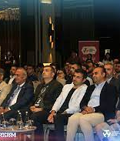
THE CAREER CENTER ORGANIZES VARIOUS MEETINGS WITHIN THE UNIVERSITY

Slide 19
ENTREPRENEURSHIP ACADEMY BRINGS YOU TOGETHER WITH BUSINESS PEOPLE

Slide 20
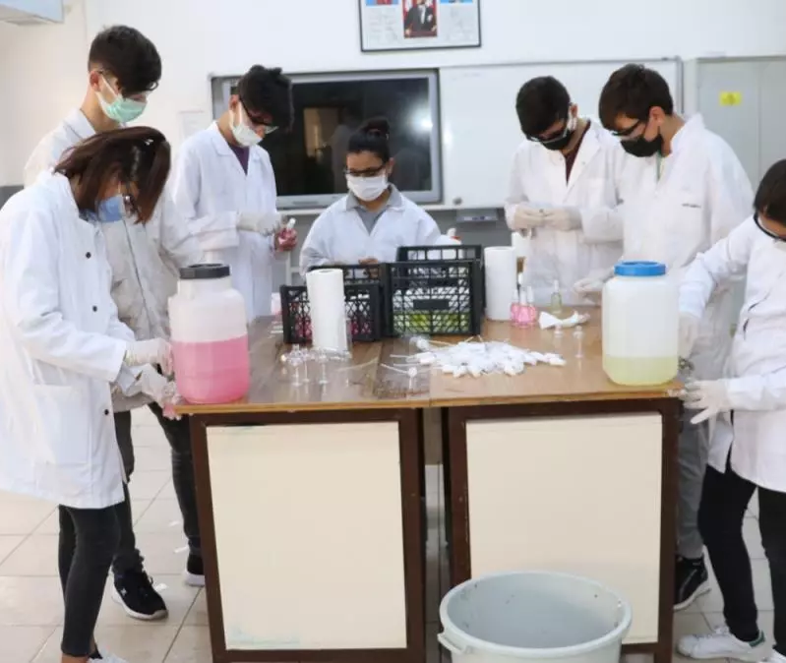
EXPERTS IN THEIR FIELDS OFFER THEIR EXPERIENCES

Slide 21
SUCCESS STORIES SHARES SUCCESS STORIES OF GRADUATES

Slide 22
CAREER CENTER ORGANIZES TRAININGS

Slide 23
CAREER CENTER ORGANIZES FAIRS AND PARTICIPATES IN FAIRS

Slide 24
Students at fairs;
You can apply to employers for jobs and internships and get information about the business world.Projelerini işverenlere sunabilir ve projeleri için sponsor bulabilir.
Can participate in seminars held at fairs.
Can participate in practical or theoretical training.

Slide 25
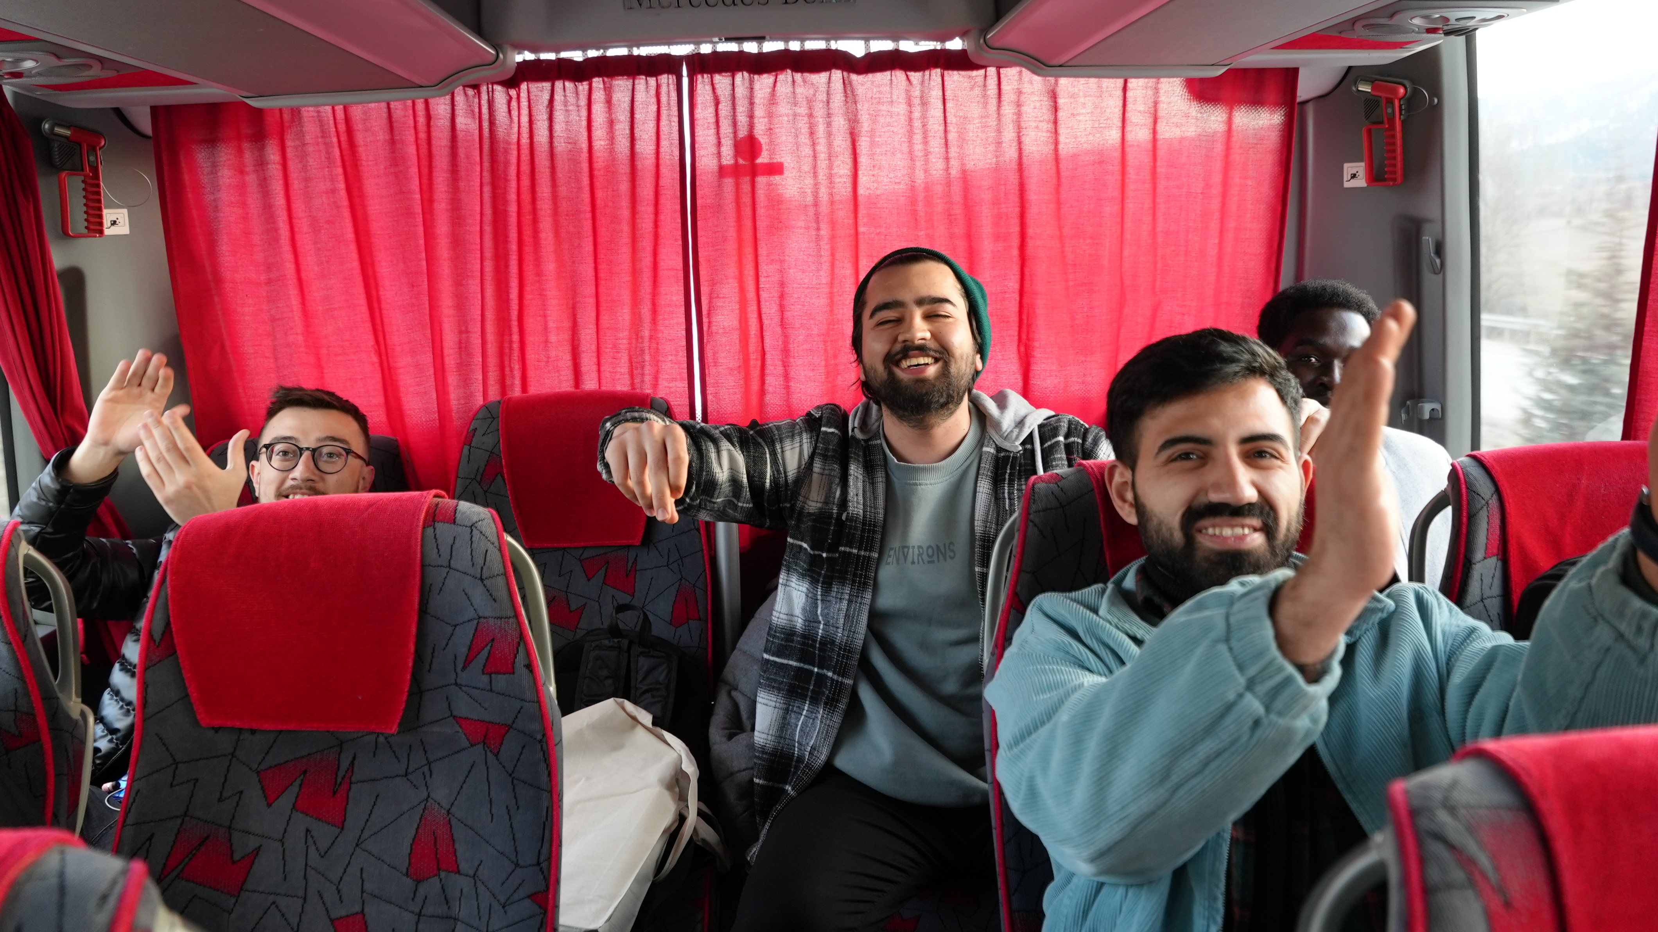
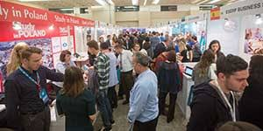

Slide 26
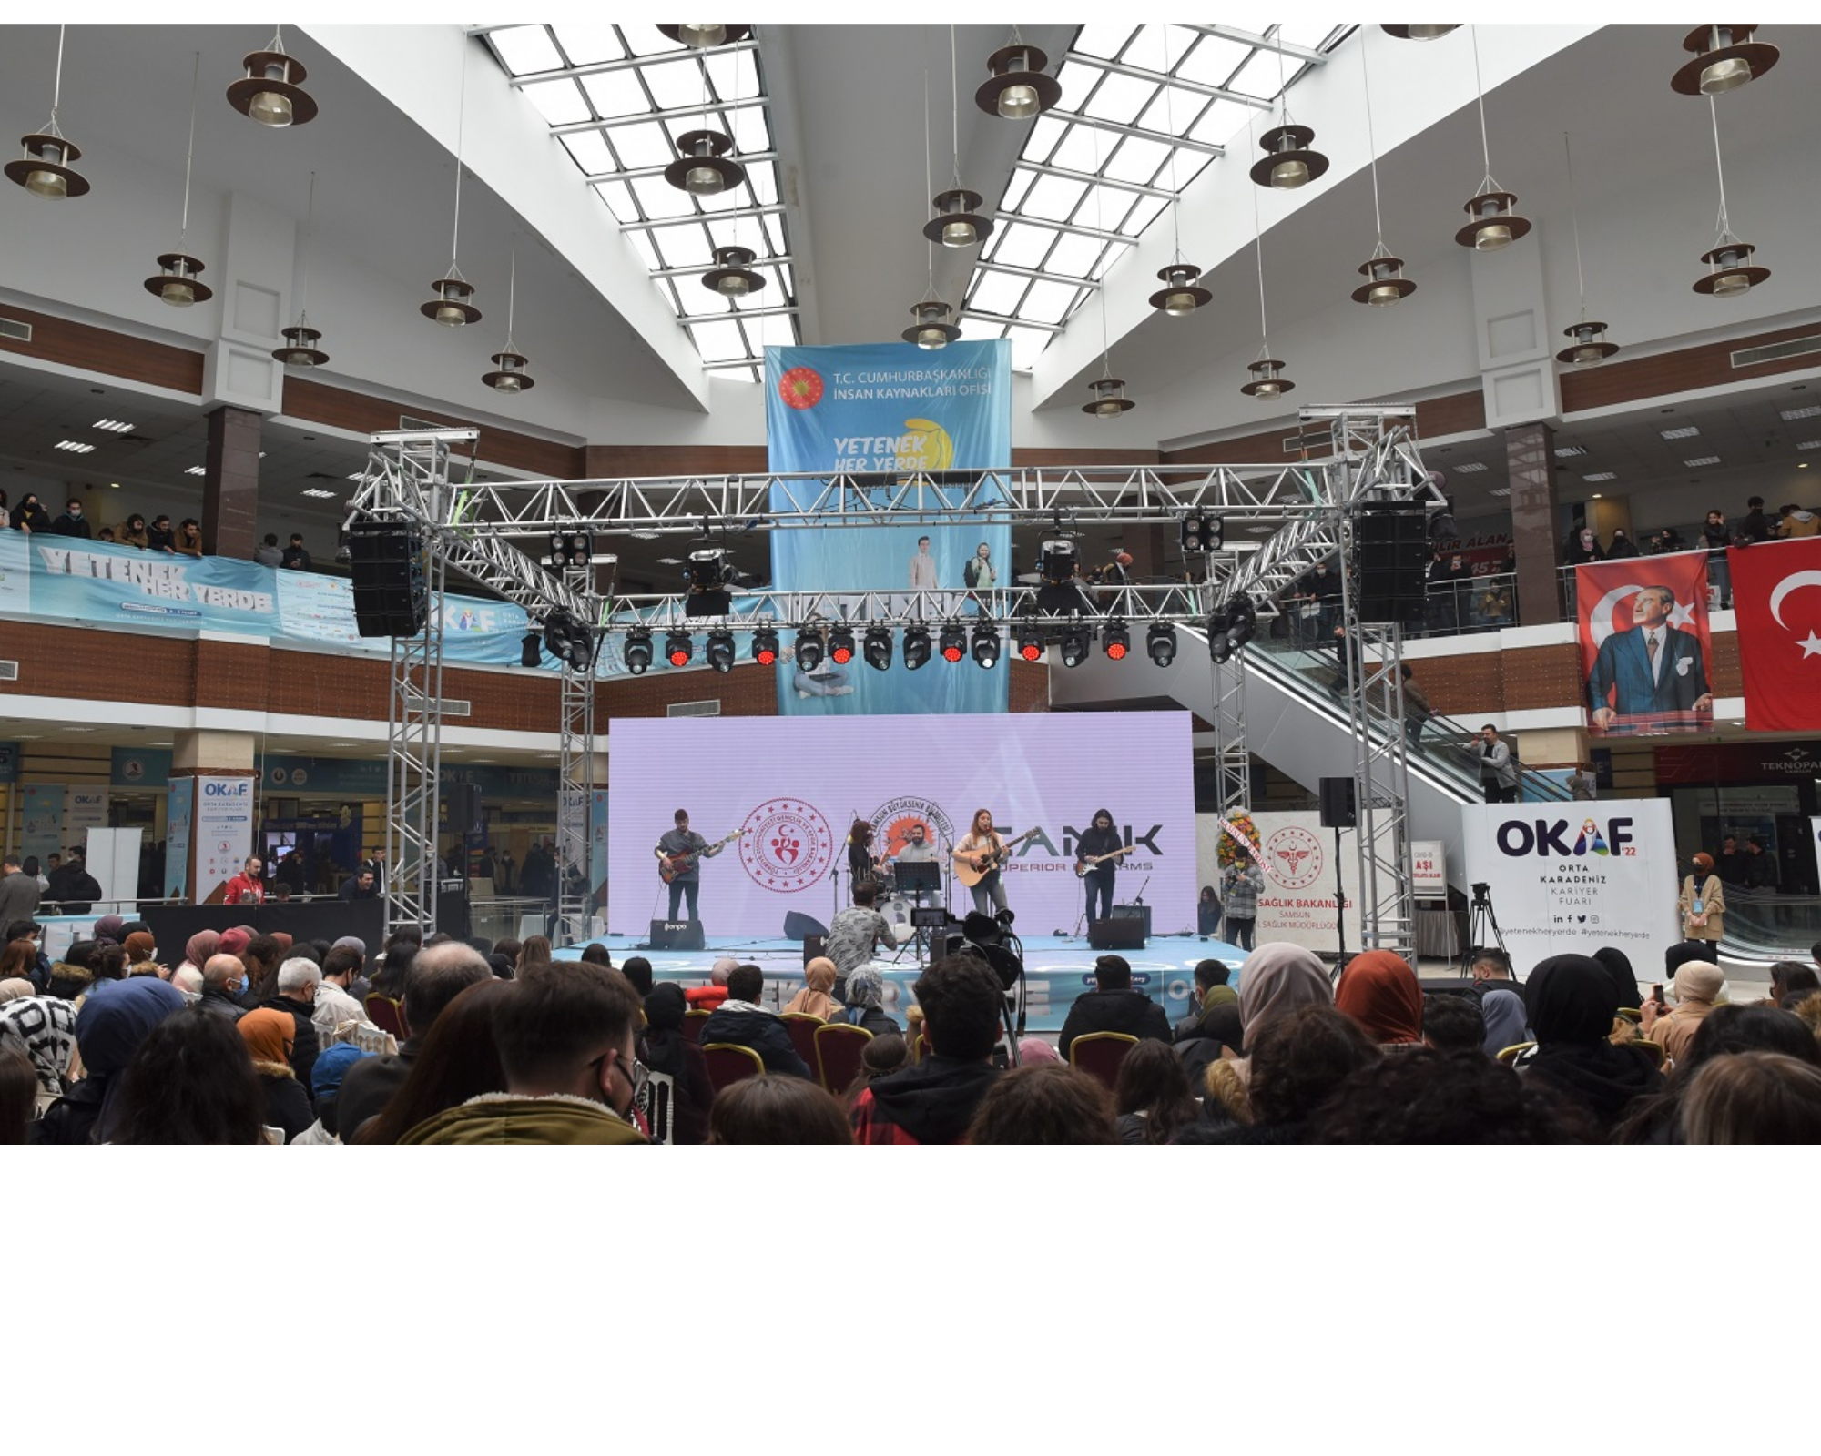

Slide 27
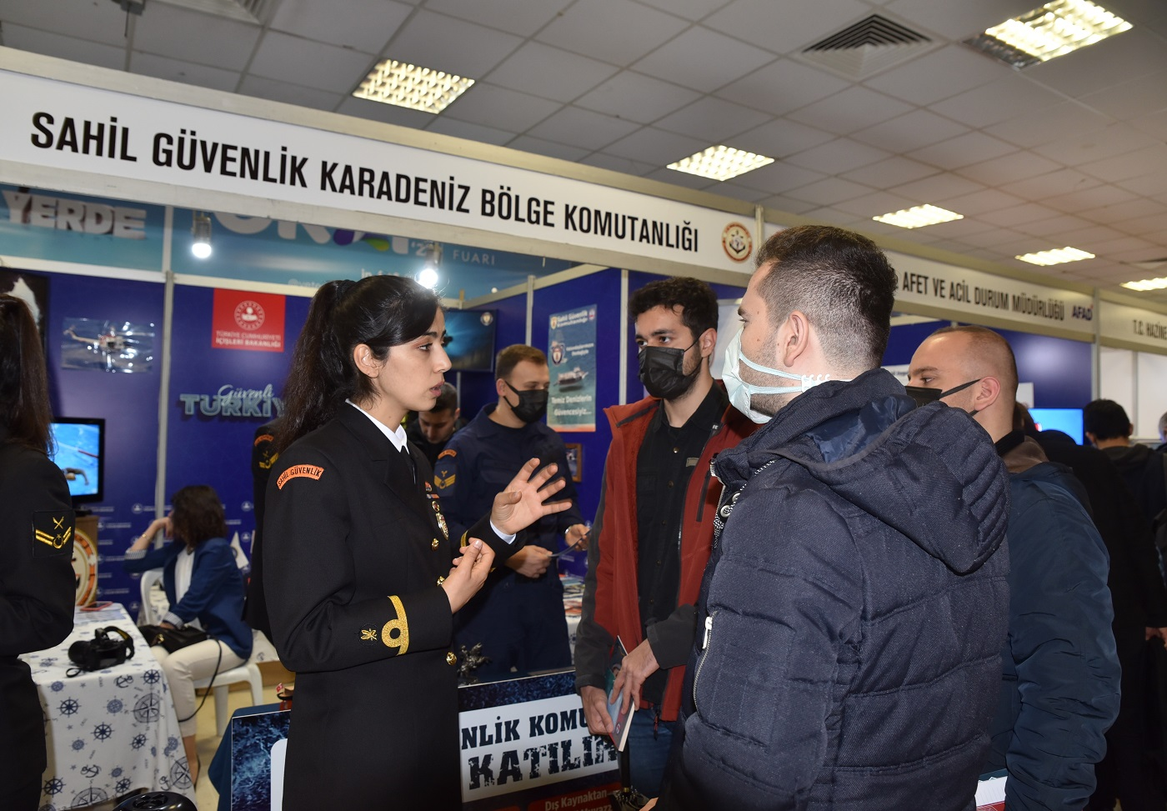

Slide 28
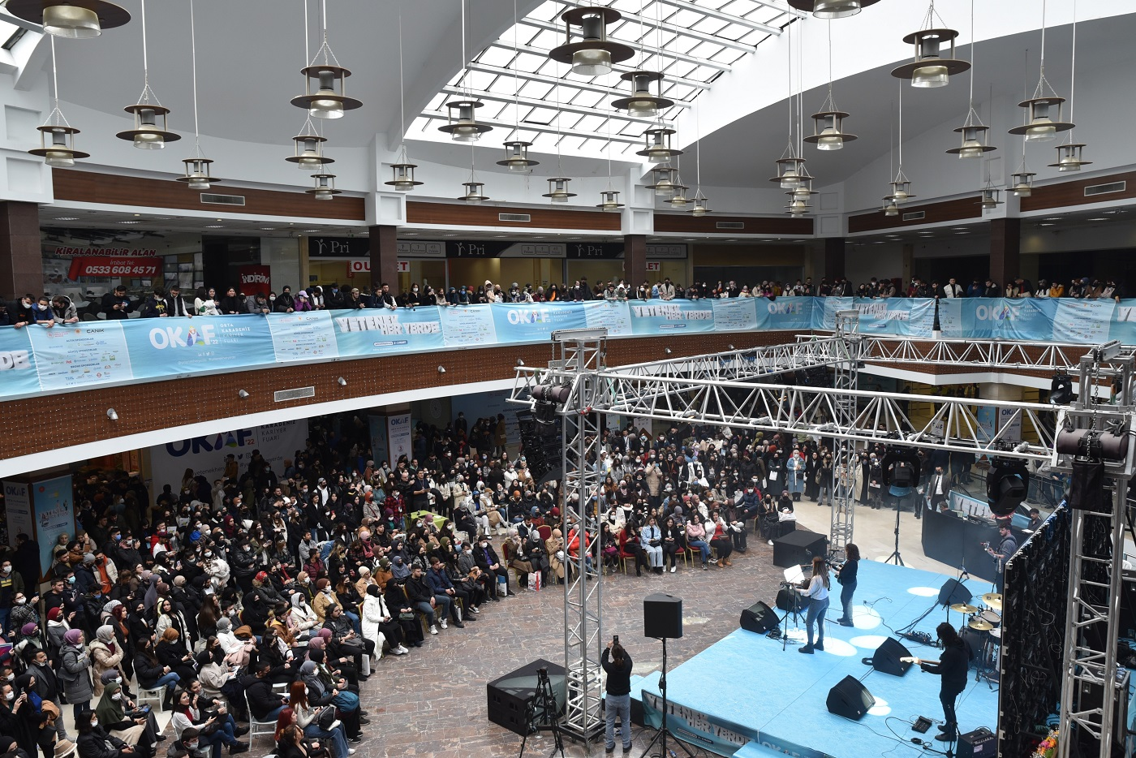

Slide 29
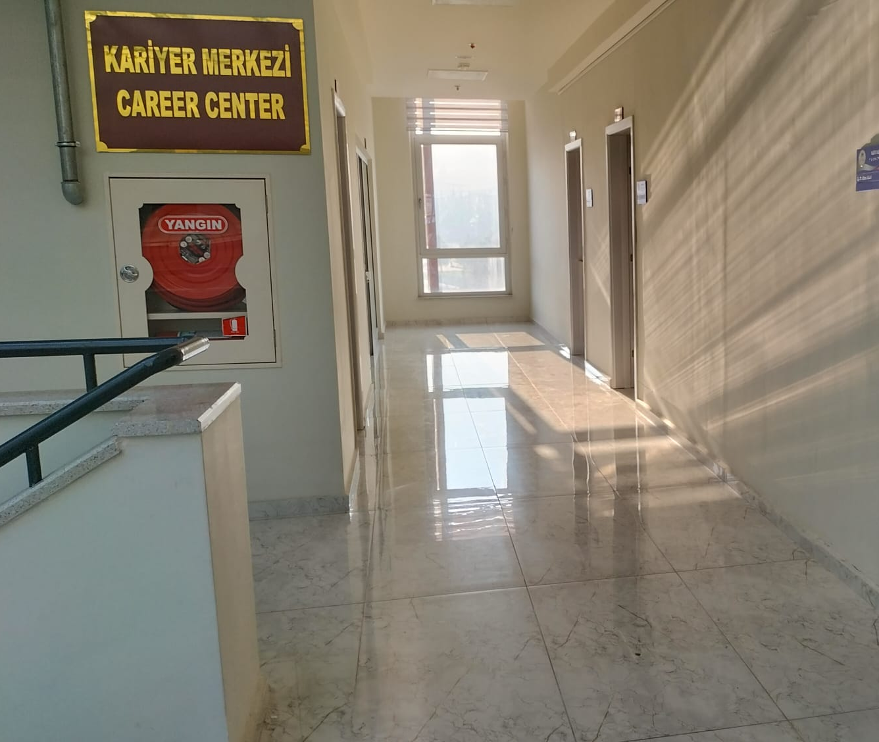
WHERE ARE WE ?
WE ARE ON THE 3RD FLOOR OF THE STUDENT AFFAIRS BUILDING.

Slide 30
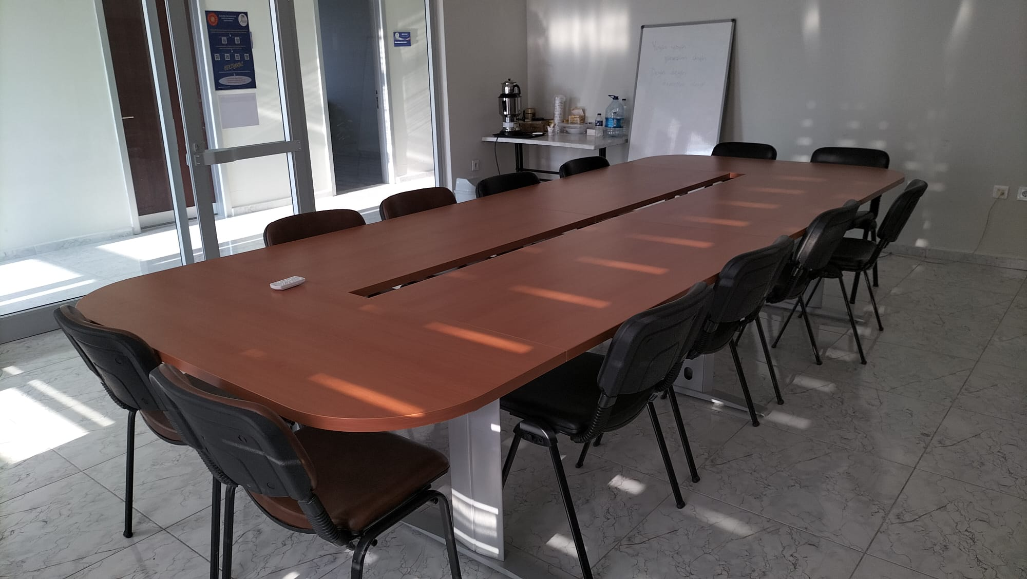

Slide 31
Sources
https://kariyer.karabuk.edu.tr/icerikGoster.aspx?K=S&id=2&BA=index.aspx
https://kariyerkapisi.cbiko.gov.tr/
ÖZDEN, M. (2015). Üniversite yönetmelikleri çerçevesinde kariyer merkezlerinin amaç ve faaliyetleri. Karadeniz Sosyal Bilimler Dergisi, 7(12), 146-170.
Cevher, E. (2015). Üniversitelerde kariyer planlama faaliyetleri ekseninde kariyer merkezlerine yönelik bir araştırma. Karabük Üniversitesi Sosyal Bilimler Enstitüsü Dergisi, 5(2), 164-177.
GÜLMEZ, N., & OKUR, M. E. (2021). Üniversite kariyer merkezlerinin dünyadaki gelişimi ve Türkiye örneği. TroyAcademy, 6(1), 137-157.
https://www.yetenekkapisi.org/
https://ytnk.tv/egitim-detay/kariyer-planlama-dersi/3FF644FE-874B-4EC2-8E14-768F7B304356

Slide 32
BİZE VAKİT AYIRDIĞINIZ İÇİN TEŞEKKÜR EDERİZ.
https://kariyer.karabuk.edu.tr/
kgo@karabuk.edu.tr
kariyerkbu
unikarmer
unikarmer
KARİYER UYGULAMA VE ARAŞTIRMA MERKEZİ

